Slide 1
Step 3 Azure Functions

Slide 2
Goal
React when a new message is pushed to an Azure Storage Queue, and read the message using Serverless services: Azure Functions.

Slide 3
Before cloud
On-Premises
Co-Lo

Slide 4
Before cloud
What happens in case of
server hardware failure?
What is the right size of
servers for my business needs?
Which packages should
be on my server?
How I scale my app?
How can I increase server utilization?
What media should I
use to keep backup?
How I deploy new code to my server?
Who monitors
my Servers?
Who monitors
my App?
How often should I backup
my server?
What storage I need to use?
What size of servers
should I buy?
Who has physical
access to my servers?
Are my server in a
secure location?
Do I need secondary
network connection?
Which OS should I use?
How many servers
do I need?
What happens if the
power goes out?
How can I dynamically
configure my app?
Do I need a UPS?
It takes how long to provision a new server?
How often should
I patch my servers?

Slide 5
Then came IaaS …
What happens in case of
server hardware failure?
What is the right size of
servers for my business needs?
Which packages should
be on my server?
How I scale my app?
How can I increase server utilization?
What media should I
use to keep backup?
How I deploy new code to my server?
Who monitors
my Servers?
Who monitors
my App?
How often should I backup
my server?
What storage I need to use?
What size of servers
should I buy?
Who has physical
access to my servers?
Are my server in a
secure location?
Do I need secondary
network connection?
Which OS should I use?
How many servers
do I need?
What happens if the
power goes out?
How can I dynamically
configure my app?
Do I need a UPS?
It takes how long to provision a new server?
How often should
I patch my servers?

Slide 6
It is PaaS time?
What is the right size of
servers for my business needs?
Which packages should
be on my server?
How I scale my app?
How can I increase server utilization?
How I deploy new code to my server?
Who monitors
my App?
How often should I backup
my server?
Which OS should I use?
How many servers
do I need?
How can I dynamically
configure my app?
How often should
I patch my servers?

Slide 7
It is PaaS time?
What is the right size of
servers for my business needs?
Which packages should
be on my server?
How I scale my app?
How can I increase server utilization?
How I deploy new code to my server?
Who monitors
my App?
How often should I backup
my server?
Which OS should I use?
How many servers
do I need?
How can I dynamically
configure my app?
How often should
I patch my servers?

Slide 8
Serverless . . .
What is the right size of
servers for my business needs?
How I architect my app
to become serverless
How I scale my app?
How can I increase server utilization?
How many servers
do I need?

Slide 9
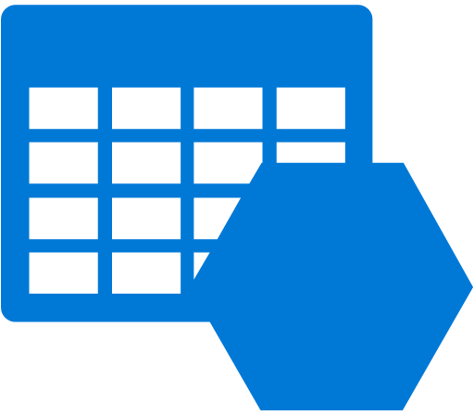



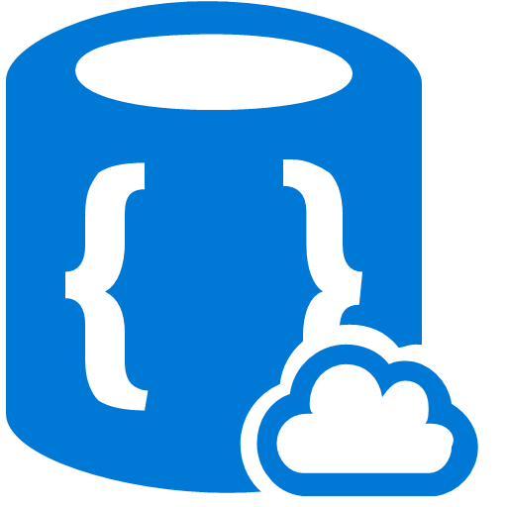










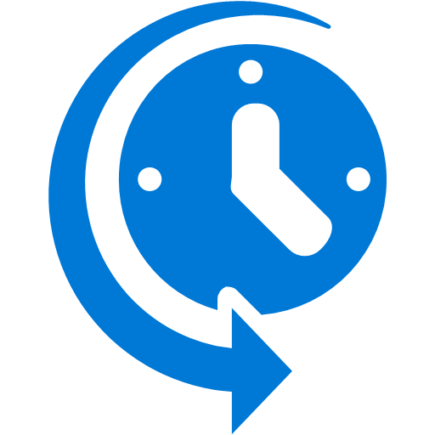




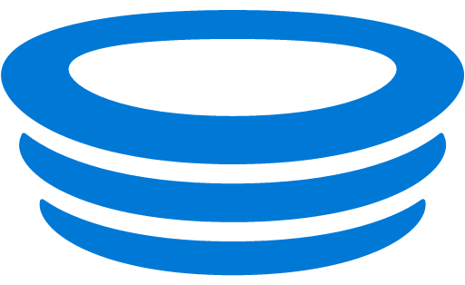
Building Serverless Apps on Azure
Functions
Logic App
Storage
Media Services
Cortana
Management Suite
Traffic Manager
Document DB
CDN
Machine Learning
OMS
Management Suite
Visual Studio
Services
Search
Active Directory
Key Vault
App Insights
Cognitive Services
Embedded Power BI
Scheduler
IoT Hub
Service Bus
Notification Hub
Stream Analytics
Hockey App

Slide 10
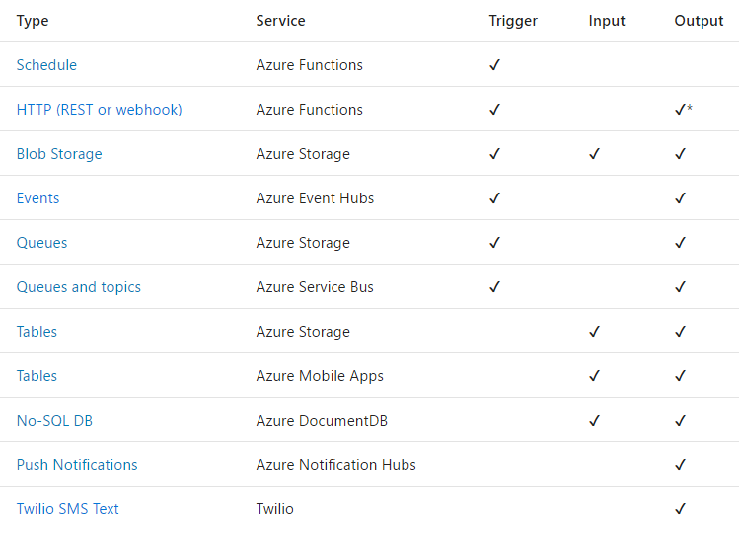
Triggers
and
Bindings

Slide 11
Let’s code!

